Slide 1
MODULE 3 INFORMATION SECURITY [3 0 0 3] ICT 3126:

Slide 2
10.4 ELGAMAL CRYPTOSYSTEM
Public-key cryptosystem.
Inventor, Taher ElGamal
Based on the discrete logarithm
.

Slide 3
10.4 ELGAMAL CRYPTOSYSTEM
If p is a very large prime, e₁ is a primitive root in the group G = <Zp*, × > and r is an integer, then e₂ = e₁^{r} mod p is easy to compute using the fast exponential algorithm,
but
given e₂, e₁, and p, it is infeasible to calculate r = log_{e1}e₂ mod p (discrete logarithm problem).
.

Slide 4
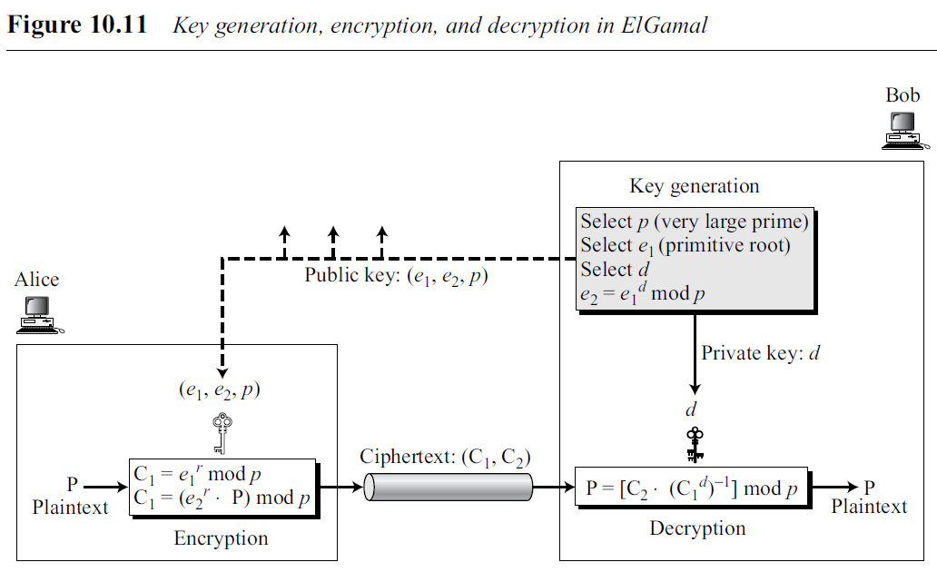
10.4 ELGAMAL CRYPTOSYSTEM
Figure shows key generation, encryption, and decryption in ElGamal
C₂
r = log_{e1}e₂ mod p
.

Slide 5
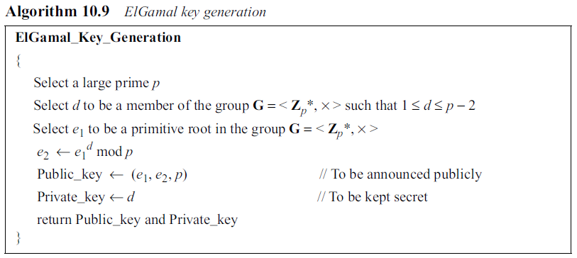
10.4 ELGAMAL CRYPTOSYSTEM
Key Generation algorithm to create public and private keys.
.

Slide 6
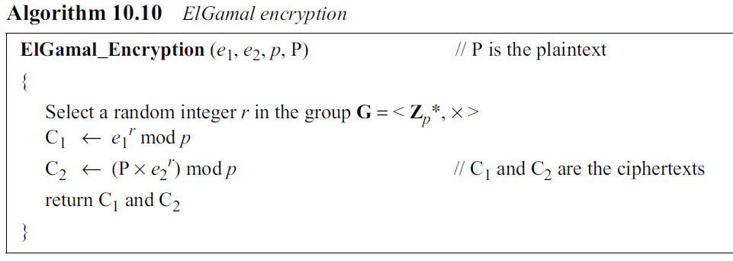
10.4 ELGAMAL CRYPTOSYSTEM
Encryption
.

Slide 7
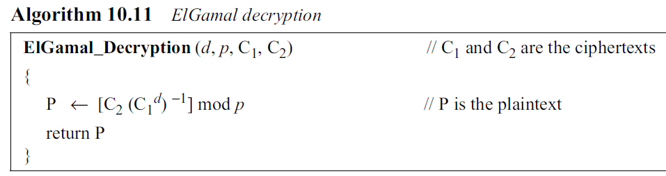
10.4 ELGAMAL CRYPTOSYSTEM
Decryption
.

Slide 8
10.4 ELGAMAL CRYPTOSYSTEM
Proof
The ElGamal decryption expression C₂ × (C₁^{d})⁻¹ can be verified to be P through substitution:
.

